Slide 1
בס"ד Cryptography Project
Safe, secret based computation system.
Authors:
Nir Amar, Etai Hazan and Yarden Eitan.

Slide 2
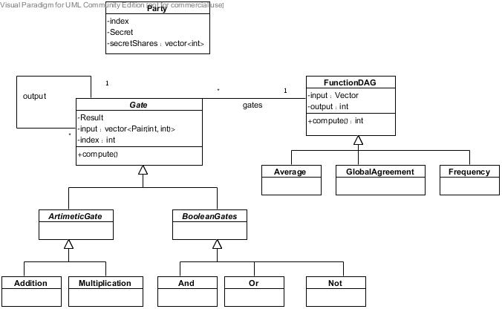
System Design & implementation first design

Slide 3
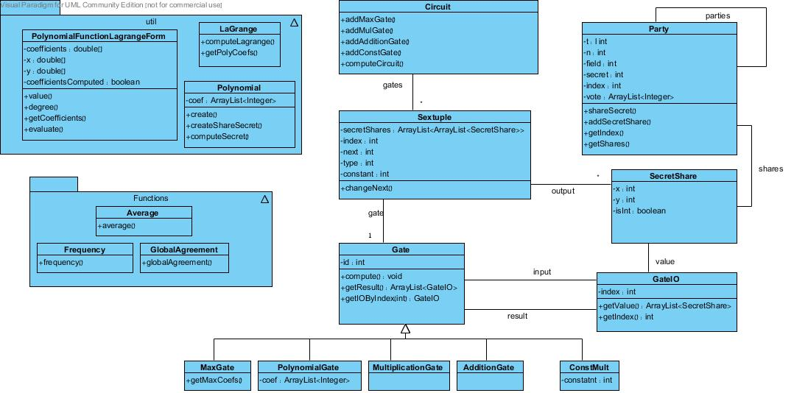
System Design & implementation final design

Slide 4
Graph Representation
Each arithmetic gate is a node in the graph
Directed edge from node A to node B exists if the output of arithmetic gate A is the input of the arithmetic gate B.
Class Sextuple contains:
Reference to gate.
2-dimensions array of secret shares - input
index of the gate
index of the output gate
type of the gate
array of secret share – output
constant – relevant only for constMult gate
Notes:
Reference to gate.
2-dimensions array of secret shares – the input for the gate
index of the gate
index of the output gate – index of the gate that the output vector will be deliver to
type of the gate - //0 = addition, 1 = multiplication, 2 = constmult, 3 = maximum
array of secret share – output – the result after the gate has been calculated
constant – relevant only for constMult gate – the constant of the constMult gate

Slide 5
Graph Computation
Define a topological sort on the graph to solve synchronization problems (done by the programmer).
Compute the function by the topological order.
Three phases:
Calculation
Update output
Update next sextuple input
Notes:
The topological sort done by inserting the gates to the circuit in the right order.
The computation is according to the indexes of the gates
Three phases:
Calculation – calculate the output according to the input and the type of the gate (use compute())
Update output – assign the result to output
Update next sextuple input – find next sextuple according to next index and initialize its input.

Slide 6
Functions
Average.
Global Agreement.
Frequency.

Slide 7
Average - motivation
Useful for:
Average of a course, without knowing other peoples grades.
Average Salaries in a company, without knowing the other employees salaries.

Slide 8
Average - implementation
Average function represents by arithmetic gates:
level one - Addition gates.
Level 2 – local computation (1/n).

Slide 9
Average – Example
3 secrets – s1=1, s2=2, s3=3.
T=1, n = 3, field = 7.
secret shares for p1 (s1)
[(1,0)(2,6)(3,5)]
secret shares for p2 (s2)
[(1,0)(2,5)(3,3)]
secret shares for p3 (s3)
[(1,5)(2,0)(3,2)]

Slide 10
Average – Example
Local computation (addition gates):
P1 = [1,5]
P2 = [2,4]
P3 = [3,3]
Result = 6
Every party do local computation (1/numOfParties)
Average = 6/3 = 2

Slide 11
Average – Example
P1
P2
P3
(1,0)
(1,0)
(1,5)
(2,6)
(2,5)
(2,0)
(3,5)
(3,3)
(3,2)
+
+
+
(1,0)
(2,4)
(3,1)
+
+
+
(1,5)
(2,4)
(3,3)
6

Slide 12
Global agreement - motivation
Useful for:
For peace in the Middle East.
Global agreements in Business meetings.

Slide 13
Global agreement - implementation
Global Agreement function represents by Boolean gates:
And gates of all inputs.

Slide 14
Global agreement - Example
3 secrets – s1=1, s2=0, s3=1.
T=1, n = 3, field = 7.
secret share for p1 (s1)
[(1,0)(2,6)(3,5)]
secret share for p2 (s2)
[(1,5)(2,3)(3,1)]
secret share for p3 (s3)
[(1,4)(2,0)(3,3)]
Notes:
(s1*s2)*s3

Slide 15
Global agreement - Example
[(1,0)(2,6)(3,5)]
[(1,5)(2,3)(3,1)]
[(1,4)(2,0)(3,3)]
*
[(1,4)(2,1)(3,5)]
*
0

Slide 16
Frequency - Motivation
Useful for:
Knowing who is the winner in an election.
(max votes)

Slide 17
Frequency – implementation
Phase 1 – create secret shares
Phase 2 – local addition computation
Phase 3 – calculate max from sums
* note: after phase 2 no party (or t parties) can study anything from the Vector about the original secretes.
Notes:
Phase 1 – create secret shares - input is Vector of integers. For each vector create secrete share so we get input is 2-dimension array of secret share.
Phase 2 – local addition computation - every party calculate his part at every index so every party has now vector of result
Phase 3 – calculate max from sums – max over 2 sums, the input for next max is do a*z +b*(1-z) a, where z is the output of max and a,b are the sums, and so on until we got the maximum sum.

Slide 18
Frequency – Example
3 secrets – s1=[1,0,0], s2=[0,1,0], s3=[1,0,0].
T=1, n = 3, field = 7.
secret share for p1 (s1)
[[(1,3)(2,5)(3,0)], [(1,0)(2,0)(3,0)],[(1,4)(2,1)(3,5)]]
secret share for p2 (s2)
[[(1,3)(2,6)(3,2)], [(1,5)(2,2)(3,6)], [(1,2)(2,4)(3,6)]]
secret share for p3 (s3)
[[(1,3)(2,5)(3,0)], [(1,6)(2,5)(3,4)], [(1,5)(2,3)(3,1)]]
Notes:
Phase 1 – create secret shares - input is Vector of integers. For each vector create secrete share so we get input is 2-dimension array of secret share.
Phase 2 – local addition computation - every party calculate his part at every index so every party has now vector of result
Phase 3 – calculate max from sums – max over 2 sums, the input for next max is do a*z +b*(1-z) a, where z is the output of max and a,b are the sums, and so on until we got the maximum sum.

Slide 19
Frequency – Example
P1
P2
[(1,3), (1,3), (1,3)]
[(1,0), (1,5), (1,6)]
[(1,4), (1,2), (1,5)]
[(2,5), (2,6), (2,5)]
[(2,0), (2,2), (2,5)]
[(2,1), (2,4), (2,3)]
+’
+’
[(1,2), (1,4), (1,4)]
P3
[(2,2), (2,0), (2,1)]
[(3,0), (3,2), (3,0)]
[(3,0), (3,6), (3,4)]
[(3,5), (3,6), (3,1)]
+’
[(3,2), (3,3), (3,5)]
Notes:
+’ – composition of addition gates, add the tuples according to index
Result – vector of sums

Slide 20
Frequency – Example
[(1,2), (2,2), (3,2)]
[(1,4), (2,0), (3,3)]
[(1,4), (2,1), (3,5)]
MAX
1
Next
[(1,2), (2,2), (3,2)]
MAX
1
Next
Result = [(1,2), (2,2), (3,2)] = 2
Notes:
MAX – return 1 if left input bigger than right input 0 otherwise
Next - a*z + (1-z)*b
Where:
z – output of MAX
a – left input
b – right input

